Slide 1
Model Building
Marketing Campaign
BY:Amira Mohamed

Slide 2
Agenda
1. Upload the Dataset 2. Import the Necessary Libraries 3. Read and Explore the Dataset 4. Handle Missing Values and Outliers 5. Encode Categorical Columns 6. Separate Features and Target 7. Train the Model 8. Evaluate the Model

Slide 3
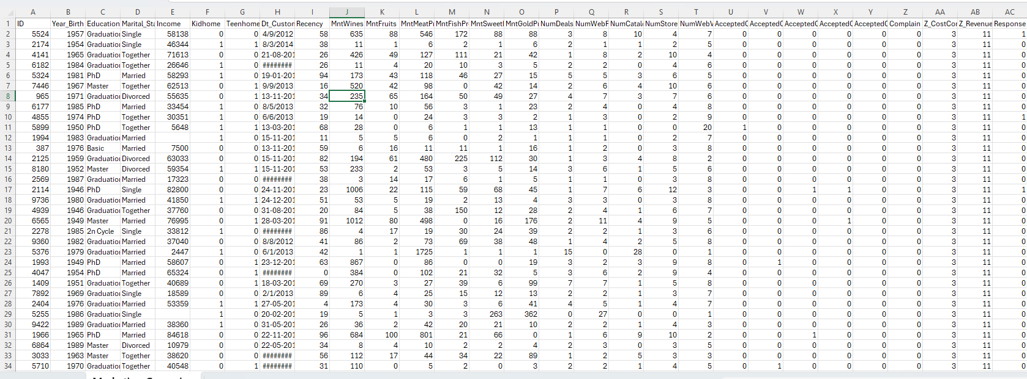
This dataset revolves around analyzing customer behavior and their response to marketing campaigns conducted by a company. It aims to understand which customers are more likely to respond positively to a campaign based on their demographics, purchasing habits, and past interactions with the company.
Columns and Samples:
Number of columns: 28.
Number of samples:2241

Slide 4
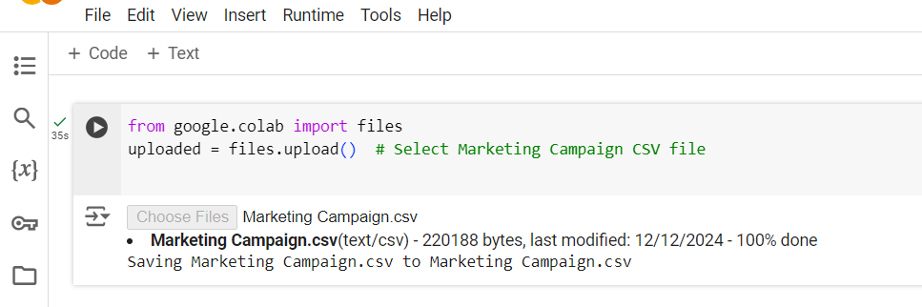
1. Upload the Dataset

Slide 5
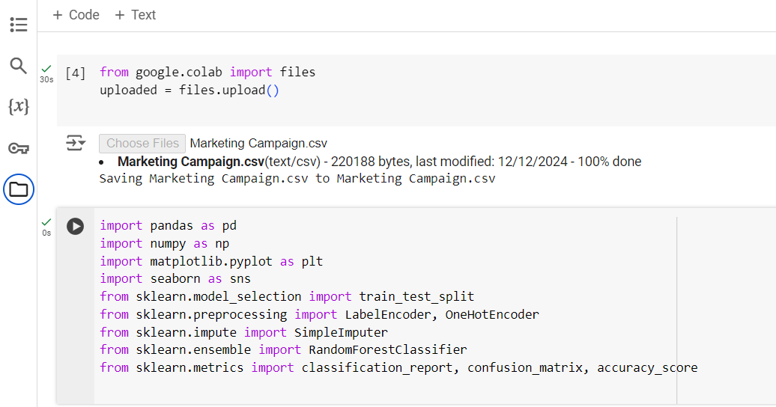
2. Import the Necessary Libraries : import the required libraries for DA and ML

Slide 6
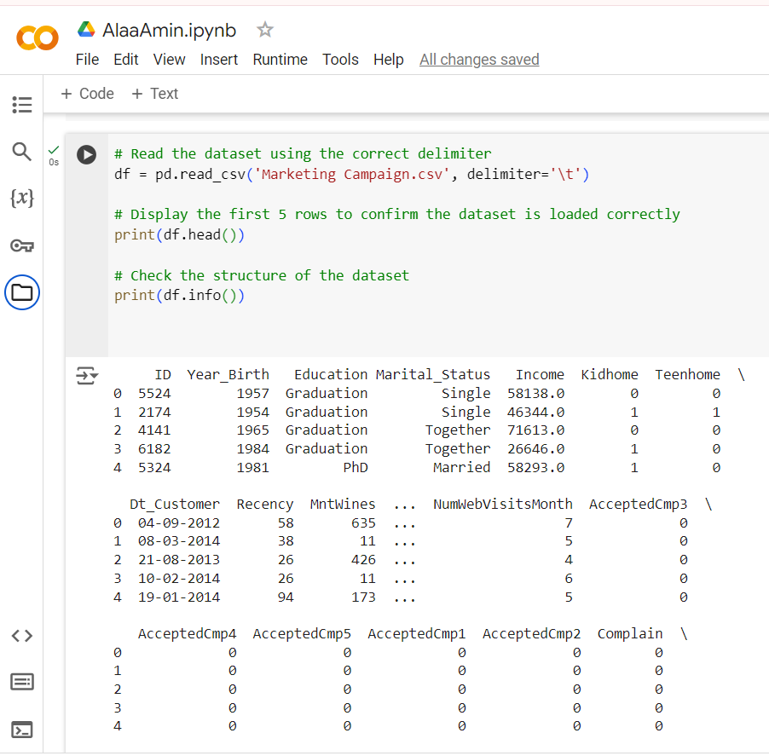
3. Read and Explore the Dataset
df.head() :
Displays the first 5 rows of your dataset.
e.g., ID, Year_Birth, Education, etc.
Data types and values seem well-structured.

Slide 7
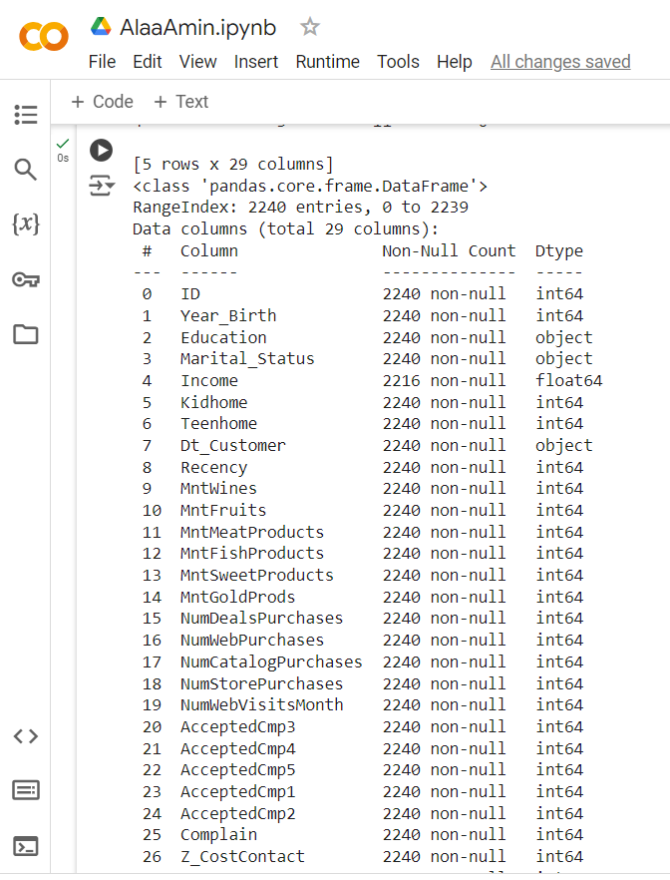
3. Read and Explore the Dataset
Insights:
Missing Values:
Income column has 24 missing values to address later.
Column Summary:
ID: Unique identifier for each customer.
Year_Birth: Birth year of the customer (age can be derived).
Education & Marital_Status: Categorical columns that require encoding.
Mnt... columns: Total amount spent on different product categories.
AcceptedCmp...: Indicates if a customer accepted marketing campaigns.
Response: The target variable, representing whether a customer responded to the last campaign.
Potential Actions:
Handle missing values in Income.
Convert Dt_Customer to a proper datetime format.
Encode categorical columns (Education, Marital_Status) for analysis.
Analyze Response as the target variable for predictions.

Slide 8
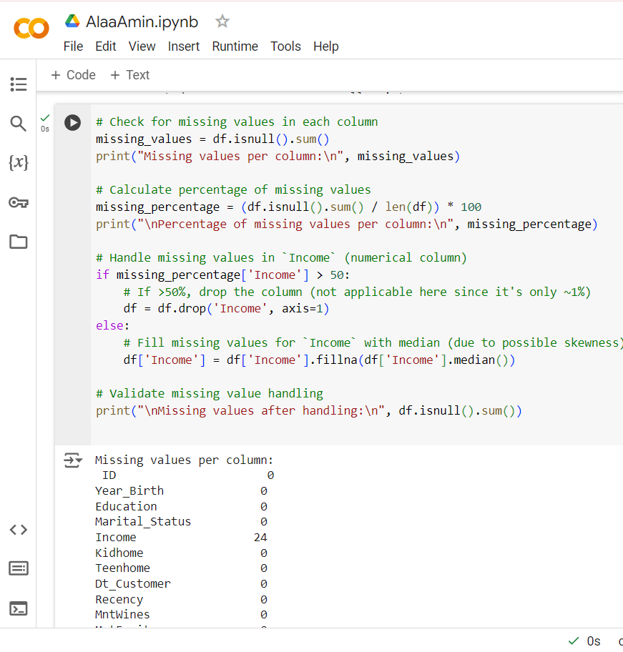

Step 4: Handle Missing Values
→ missing values in the dataset were handled successfully.

Slide 9
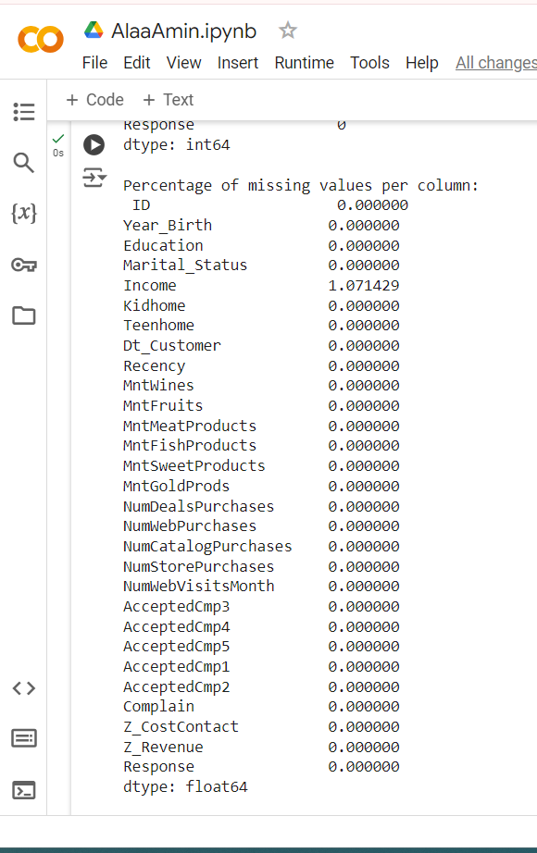
Step 4: Handle Missing Values
Step 1: Missing Values Per Column
All columns except Income have no missing values.
Income has 24 missing values (about 1.07% of the data).
Step 2: Percentage of Missing Values
The column Income has 1.07% missing values, while all other columns have 0% missing values. This means that only Income required handling.
Step 3: Handling Missing Values
The missing values in the Income column were handled by filling them with the median value of the column.
The result shows that after handling the missing values, there are no missing values left in the dataset (Income now has no missing values).

Slide 10
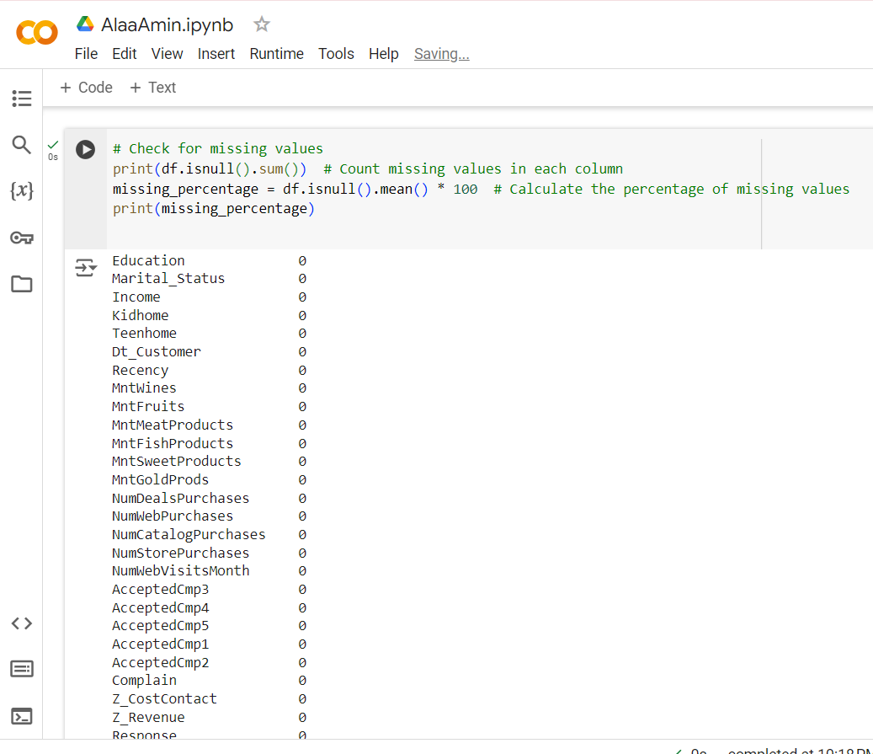
4.1. Check for Missing Values
Handle Missing Values →Drop columns with more than 50% missing values & →Fill missing values in categorical columns with the most frequent value (Mode) & →fill missing values in numerical columns with the median (for skewed distributions)
Just by looking at it there is no missing data but to avoid problems we will do Handle Missing Values Techniques.

Slide 11
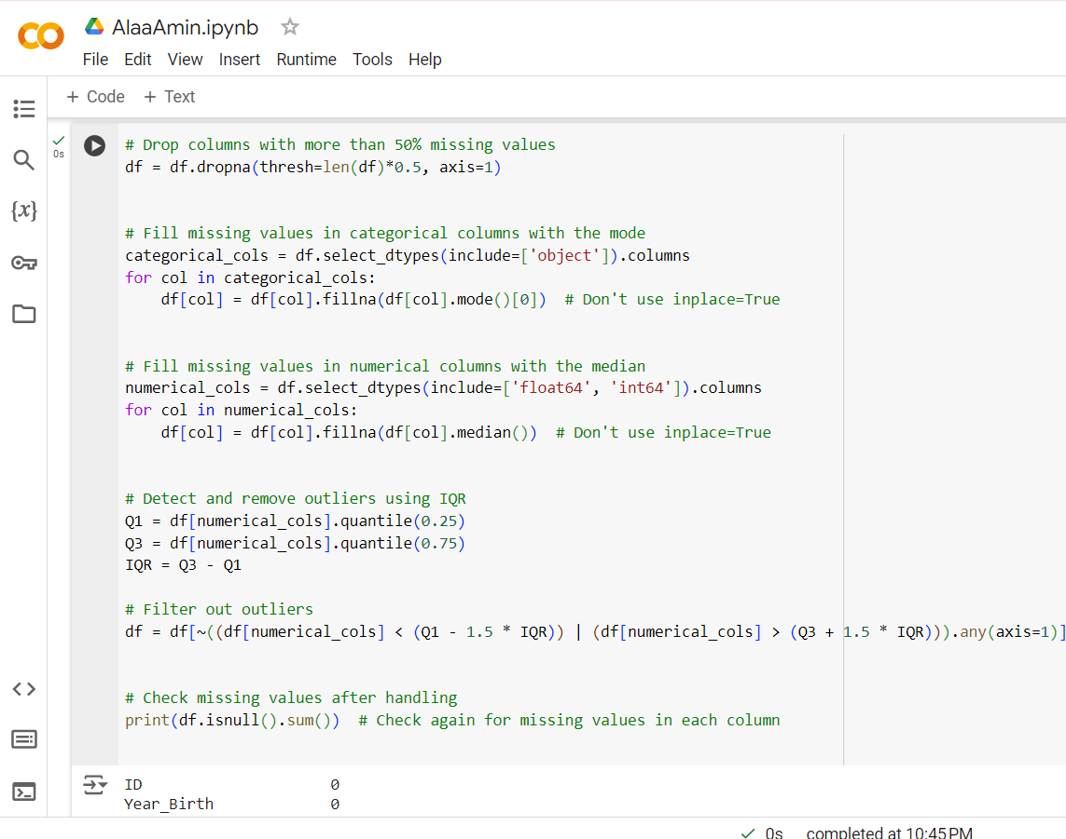
4.2. Handle Missing Values:
1.Drop columns 2.Fill With Mode 3.Fill With Median
4.3. Handle Outliers (Optional):
Outliers can affect the model performance, so we may want to handle them. A simple way to detect outliers is using the IQR (Interquartile Range) method.

Slide 12
5. Encode Categorical Columns
1. Using Label Encoding for Ordinal Columns: used when you have an ordinal variable, a variable that has a specific order. For example, "Education" with categories such as "PhD", "Graduation", etc.
2. Using One-Hot Encoding for Categorical Columns with Limited Categories:
If a categorical column has non-ordinal categories, one-hot encoding is typically used. This method converts each category into a new binary column. For example, the "Education" column can be encoded as separate columns for each education level.

Slide 13
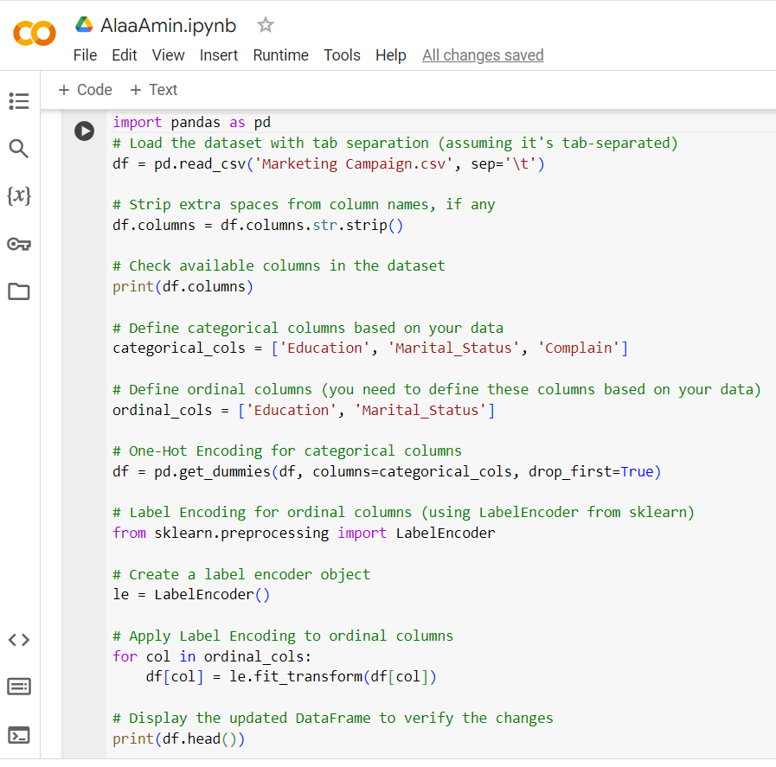
Read the dataset (handling tab-separated values).
Remove any extra spaces in column names.
One-hot encode the categorical columns (Education, Marital_Status, Complain).
Label encode the ordinal columns (Education, Marital_Status) using LabelEncoder from scikit-learn.
Display the resulting DataFrame to check the transformed data.

Slide 14
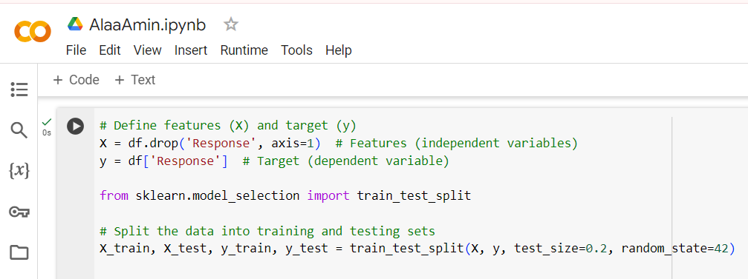
6. Separate Features and Target:
1. Split the dataset into features (X) and target (y):
The first step in preparing the dataset for machine learning is to separate the features (independent variables) from the target (dependent variable). The target variable is the one you're trying to predict or classify.
X will contain all the columns except for the target column (Response).
y will be the Response column, which is what you're predicting.
2. Split the data into training and testing sets:
Once the dataset is split into features and target, it's essential to divide the data into two sets: one for training the model (X_train, y_train) and the other for testing the model (X_test, y_test). This helps in evaluating how well your model generalizes to unseen data.
X_train and y_train are the features and target for the training set (80% of the data).
X_test and y_test are the features and target for the testing set (20% of the data).
test_size=0.2 specifies that 20% of the data will be used for testing, and the remaining 80% will be used for training.
random_state=42 ensures reproducibility of the split.

Slide 15
7. Train the Model:
we will use a Random Forest Classifier model to train on the training data. A Random Forest is a popular machine learning algorithm because it can handle both classification and regression tasks effectively, and it's robust to overfitting.
Import the RandomForestClassifier
Create and train the model:
8. Evaluate the Model:
After training the model, it's essential to evaluate its performance on the testing data (X_test and y_test).
Make Predictions:
Evaluate Performance:

Slide 16
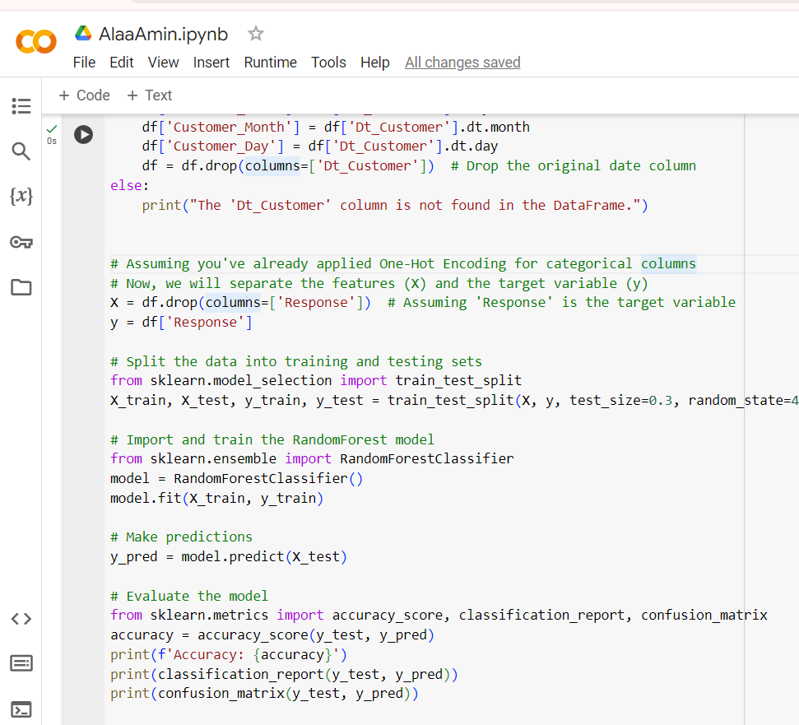
Training: model.fit(X_train, y_train) trains the Random Forest model on the training dataset.
Prediction: y_pred = model.predict(X_test) makes predictions on the test data.
Evaluation: The model's performance is evaluated using accuracy, a classification report, and a confusion matrix.

Slide 17

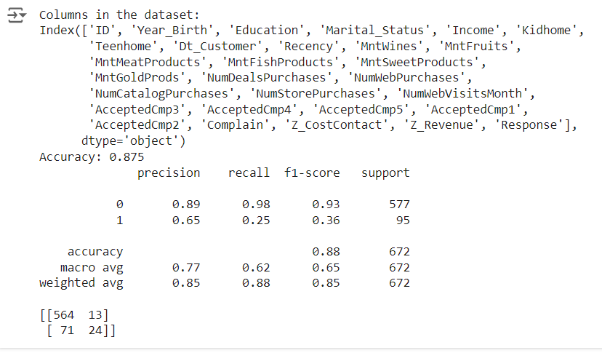

Slide 18

THANK YOU
Amira Mohamed

